Slide 1
PharmaX Category Urology Retail Performance Analysis
Presenter: Bui Diep Thanh Vy
Date: 20/11/2025

Slide 2
Contents
Overview
Revenue Analysis
Sales Volume Analysis
Top Products (Revenue & Quantity)
Lost Sales Analysis
Stock Performance
Assortment Compliance
Key Insights
Recommendations

Slide 3
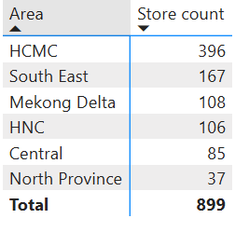
Overview
16 Urology SKUs included in the dataset
899 stores nationwide
14 manufacturers supplying these SKUs
Total revenue: 1.02B VND
Total quantity sold: 241K pcs
Current on-hand inventory: 387Kpcs
Total lost orders: 163
Lost sales value: 7.4M VND

Slide 4
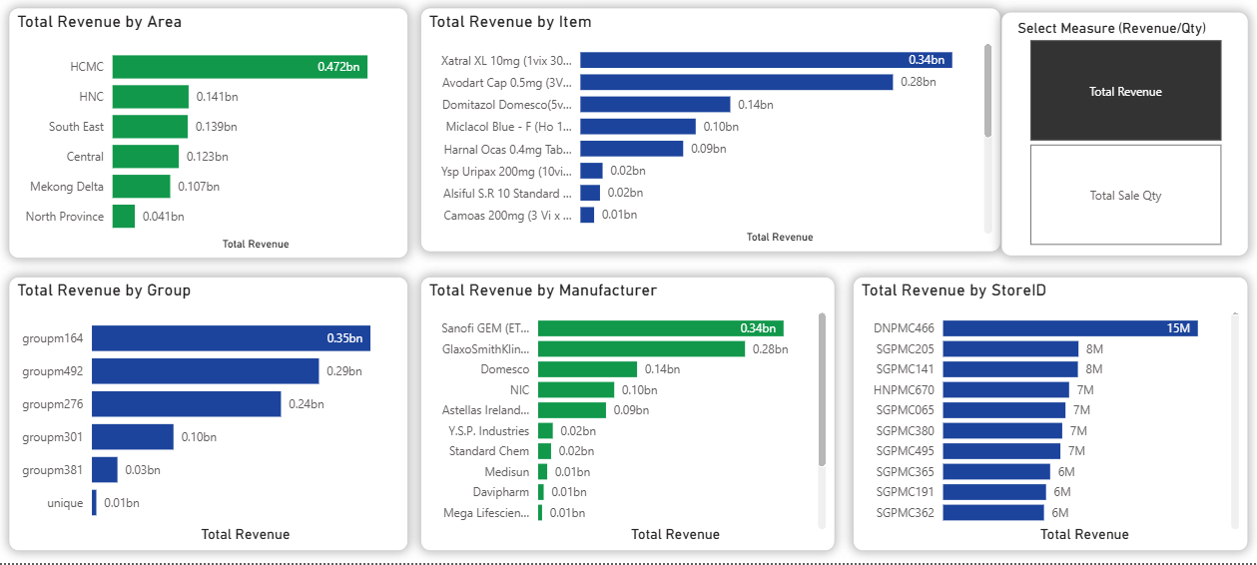
Revenue Overview
Ho Chi Minh City contributes nearly 50% of total revenue (472.3M VN)
60% of revenue is supplied by two key manufacturers: Sanofi GEM ETC and GlaxoSmithKline ETC
Store DNPMC466 is the highest-revenue store

Slide 5
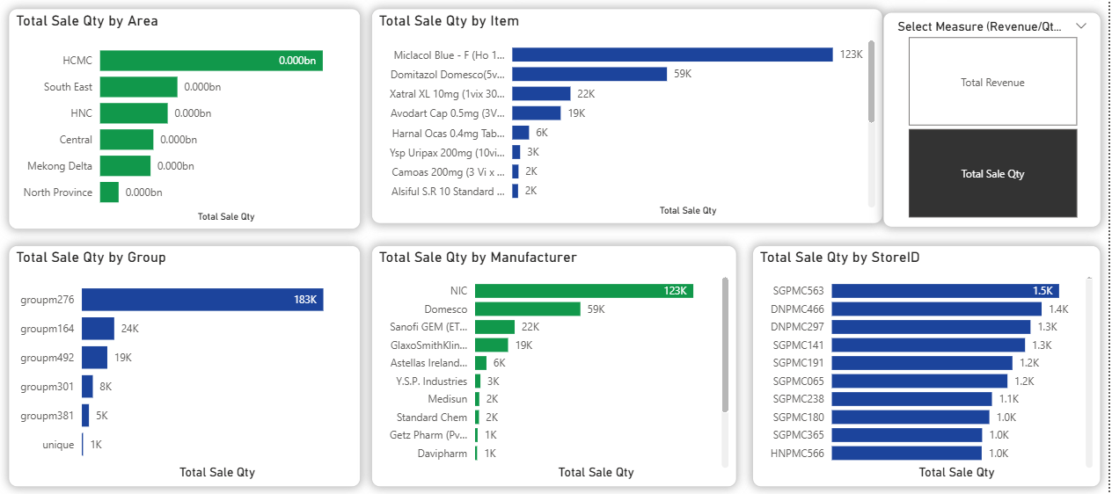
Sales Volume Overview
HCMC accounts for ~45% of total quantity sold nationwide (110K pcs)
50% of total volume is supplied by NIC, and 25% by Domesco
Store SGPMC563 records the highest sales volume

Slide 6
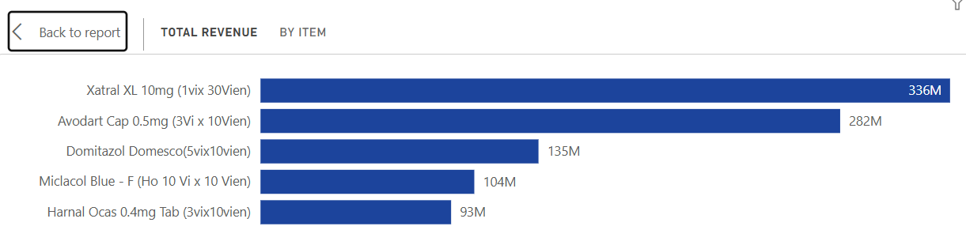
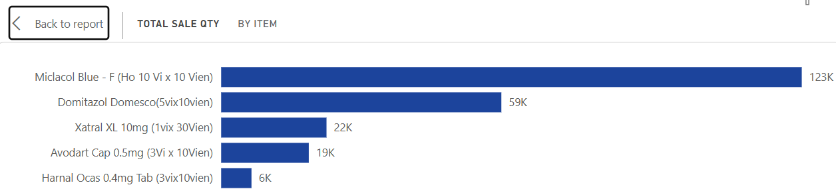
Top Products (Revenue & Quantity)
Although Xatral XL sells only 1/5 the quantity of Miclacol Blue, it generates the highest revenue, nearly 3× Miclacol Blue
Similarly, Avodart Cap ranks 4th in sales quantity but contributes the second-highest revenue

Slide 7
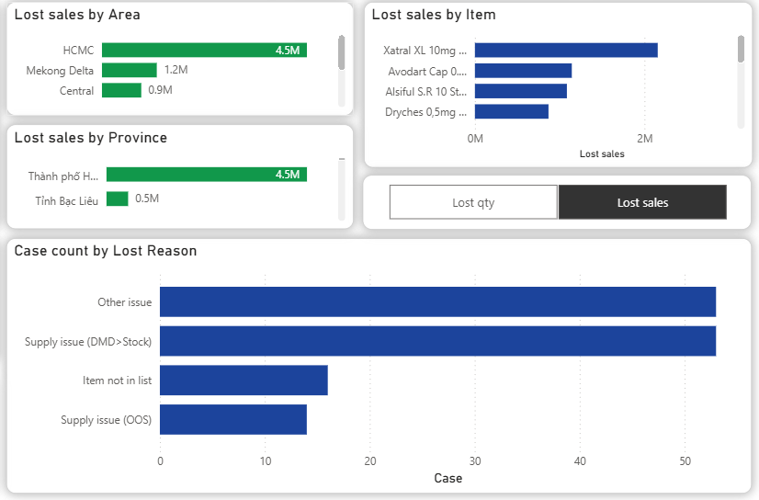
Lost Sales Analysis
Overall lost sales rate is very low at 0.71%
HCMC requires close monitoring due to its higher lost sales rate
Main causes identified:
Supply issues: insufficient stock to meet demand (67 cases)
Assortment issues: item not in the assortment list (16 cases)
Other cases: 53 situations where the store still lost orders despite having enough stock, requiring further investigation

Slide 8
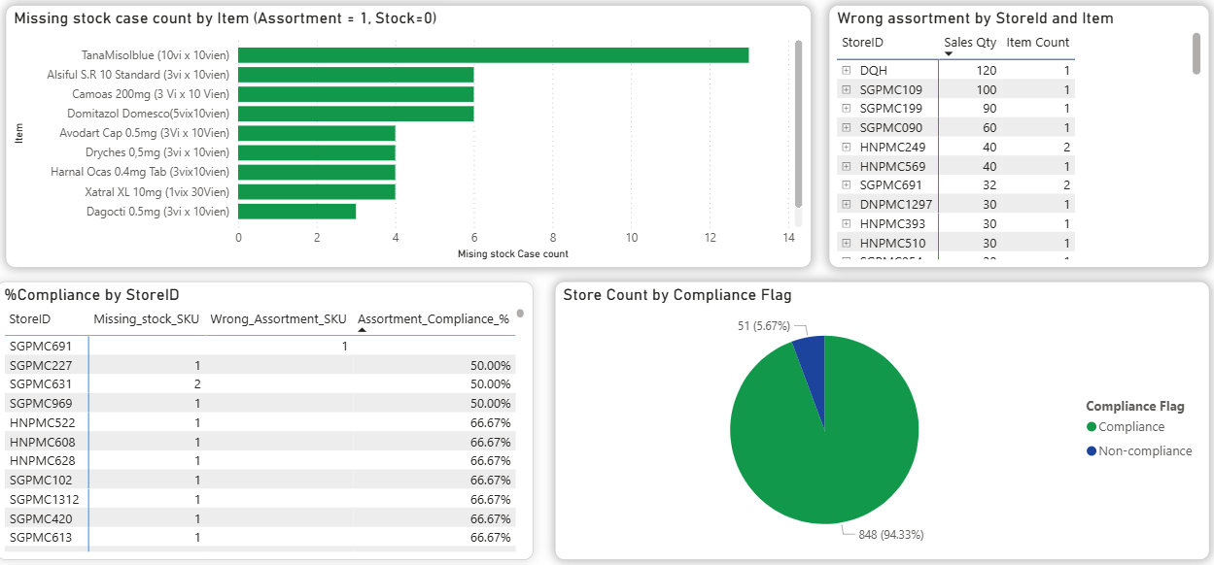
Assortment Compliance
94% of stores achieve 100% assortment compliance
Need to monitor:
Missing stock items (SKU is in assortment list but store has 0 stock)
Non-assortment SKUs with sales history (potential operational or system errors)

Slide 9
Key Insights
HCMC is the most critical market, contributing nearly half of both revenue and sales volume, but also showing high lost-sales risk
Revenue concentration is high: a few manufacturers (Sanofi & GSK) and a few SKUs drive the majority of performance
High on-hand stock (387K pcs) but 28% stores still face slow-moving inventory, indicating imbalance in stock allocation
Assortment compliance is strong overall, but some exceptions still lead to lost sales and inconsistent store execution
Certain high-value SKUs (e.g., Xatral XL, Avodart Cap) show high revenue despite relatively low volume, indicating premium and high-margin opportunities

Slide 10
Recommendations
1. Strengthen supply planning for HCMC
Prioritize replenishment and safety stock for high-velocity SKUs
Reduce lost sales in the most revenue-critical region
2. Optimize stock allocation across stores
Implement periodic store-to-store relocation for slow-moving vs. high-demand stores
Set up minimum stock thresholds for top SKUs
3. Enhance assortment governance
Review SKUs sold outside assortment → possible training/system gaps
Ensure assortment SKUs maintain minimum stock to avoid missed sales

Slide 11
Recommendations
4. Focus on high-value SKUs
Prioritize forecasting and shelf availability for Xatral XL, Avodart Cap
These SKUs offer high revenue leverage even at low unit volume
5. Investigate unexplained lost orders
53 cases where stock was available, but order was lost → requires root-cause analysis
Potential issues: system delay, cashier error, shelf display, stock accuracy mismatch

Slide 12
Thanks for your attention

